Slide 1

CHAPTER-5
Requirement Analysis
Data Modelling
Class Modelling
Department of Computer Science and Engineering
School of Engineering, Presidency University

Slide 2
Contents
Requirement Analysis
    1.1 Objectives and Philosophy
    1.2 Analysis Rule of Thumb
    1.3 Domain Analysis
    1.4 Requirements modelling approach
Scenario based Modelling
    2.1 Creating Preliminary use case
    2.2 Refining a preliminary use case
    2.3 Writing a Formal use case
UML Models
    3.1 Developing activity Diagram
    3.2 Swim lane Diagram
Dept. of CSE, SOE, Presidency University

Slide 3
Contents
Data Modelling concepts
  4.1 Data objects
  4.2 Data attributes
  4.3 Relationships
Class- Based Modelling
  5.1 Identifying Analysis classes
  5.2 Specifying attributes
  5.3 Defining operations
  5.4 CRC Modelling
  5.5 Associations and dependencies
  5.6 Analysis and packages
Dept. of CSE, SOE, Presidency University

Slide 4
1. What is Requirement Analysis?
Requirements analysis
  specifies software’s operational characteristics
  indicates software's interface with other system elements
  establishes constraints that software must meet
Requirements analysis allows the software engineer (called an analyst or modeler in this role) to:
  elaborate on basic requirements established during earlier requirement engineering tasks
  build models that depict user scenarios, functional activities, problem classes and their relationships, system and class behavior, and the flow of data as it is transformed.
Dept. of CSE, SOE, Presidency University

Slide 5
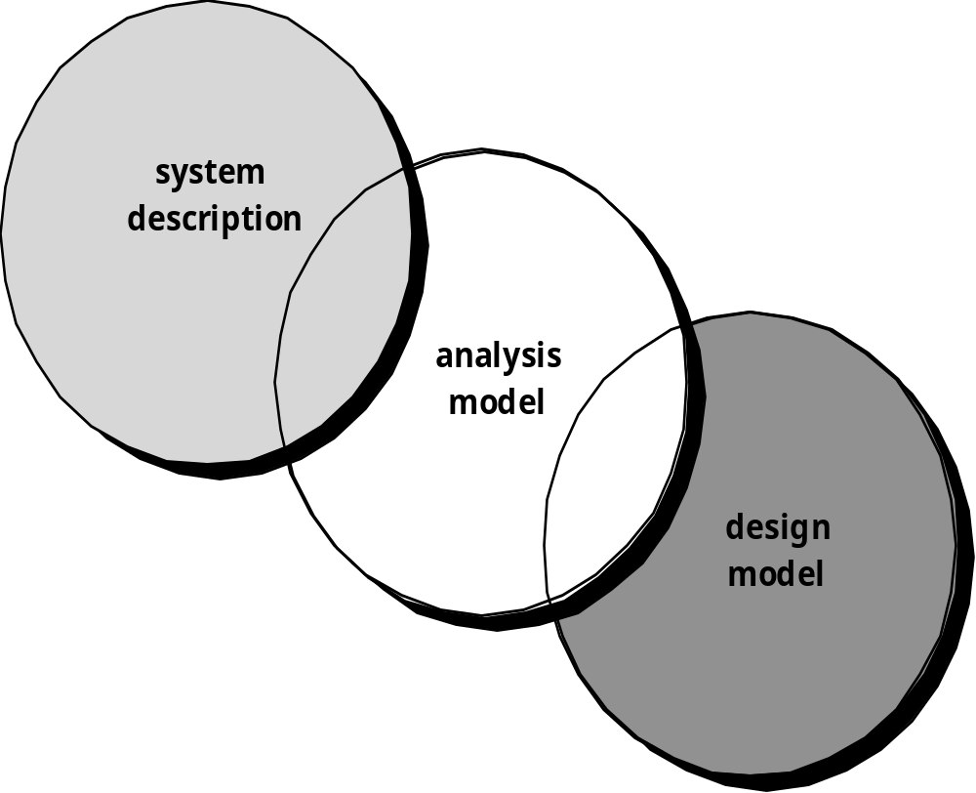
Requirement Analysis - A Bridge
Dept. of CSE, SOE, Presidency University

Slide 6
1.1 Objectives and philosophy
To describe what the customer requires
To establish a basis for the creation of a software design
To define a set of requirements that can be validated once the software is built.
Dept. of CSE, SOE, Presidency University

Slide 7
1.2 Rules of Thumb
The model should focus on requirements that are visible within the problem or business domain. The level of abstraction should be relatively high.
Each element of the analysis model should add to an overall understanding of software requirements and provide insight into the information domain, function and behavior of the system.
Delay consideration of infrastructure and other non-functional models until design.
Minimize coupling throughout the system.
Be certain that the analysis model provides value to all stakeholders.
Keep the model as simple as it can be.
Dept. of CSE, SOE, Presidency University

Slide 8
1.3 Domain Analysis
Analysis is an attempt to build a model that describes the application domain
Software domain analysis is the identification, analysis, and specification of common requirements from a specific application domain, typically for reuse on multiple projects within that application domain
Object-oriented domain analysis is the identification, analysis, and specification of common, reusable capabilities within a specific application domain, in terms of common objects, classes, subassemblies, and frameworks
Dept. of CSE, SOE, Presidency University

Slide 9
Domain Analysis
Define the domain to be investigated.
Collect a representative sample of applications in the domain.
Analyze each application in the sample.
Develop an analysis model for the objects.
Dept. of CSE, SOE, Presidency University

Slide 10
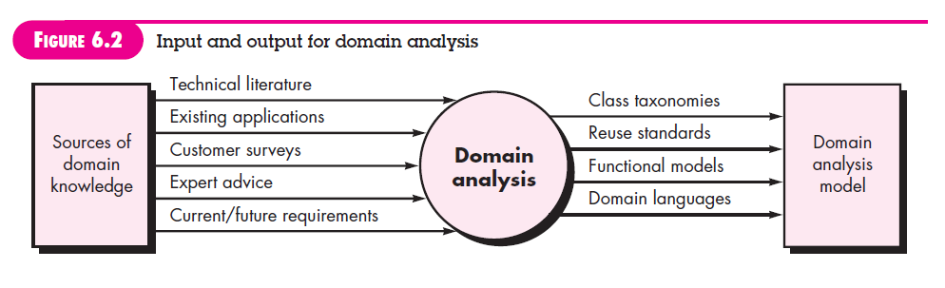
I/O for Domain Analysis
Dept. of CSE, SOE, Presidency University

Slide 11
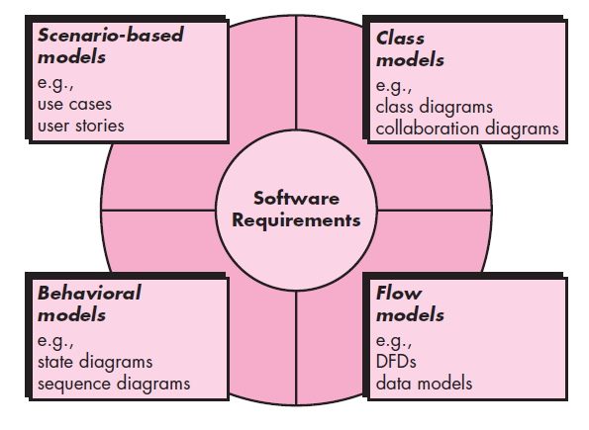
Elements of Requirement Analysis
Dept. of CSE, SOE, Presidency University

Slide 12
2. Scenario-Based Models
  “[Use-cases] a“[Use-cases] are simply an aid to defining what exists outside the system (actors) and what should be performed by the system (use-cases).” - Ivar Jacobson
  Represented via use cases
2.1 Creating Preliminary use case
  What to write about? – Inception and elicitation will provide the information for begin with use cases.
2.2 Refining Preliminary use case
2.3 Writing a formal use case
Dept. of CSE, SOE, Presidency University

Slide 13
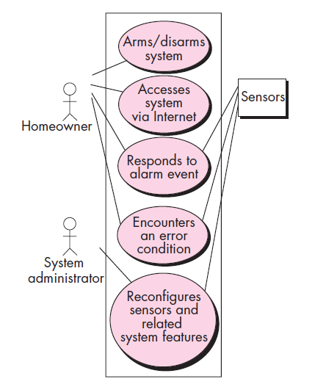
Scenario-Based Models
Use Case Diagram of Safe Home System
Dept. of CSE, SOE, Presidency University

Slide 14
3. UML Models that supplement the Use Case
3.1. Activity Diagram
Supplements the use case by providing a graphical representation of the flow of interaction within a specific scenario.
3.2. Swimlane Diagram
Allows the modeler to represent the flow of activities described by the use-case and at the same time indicate which actor (if there are multiple actors involved in a specific use-case) has responsibility for the action described for an activity.
Dept. of CSE, SOE, Presidency University

Slide 15
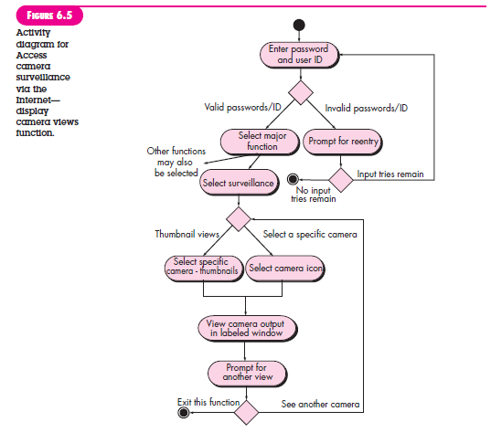
Activity Diagram
Dept. of CSE, SOE, Presidency University

Slide 16
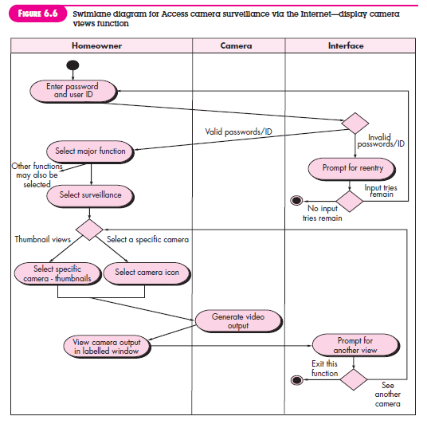
Swimlane Diagram
Dept. of CSE, SOE, Presidency University

Slide 17
4. Data Modeling
Examines data objects independently of processing
Focuses attention on the data domain
Creates a model at the customer’s level of abstraction
Indicates how data objects relate to one another
Dept. of CSE, SOE, Presidency University

Slide 18
What is a Data Object
Can be an external entity (e.g., anything that produces or consumes information), a thing (e.g., a report or a display), an occurrence (e.g., a telephone call), an event (e.g., an alarm), a role (e.g., salesperson), an organizational unit (e.g., accounting department), a place (e.g., a warehouse), or a structure (e.g., a file).
The description of the data object incorporates the data object and all of its attributes.
A data object encapsulates data only - there is no reference within a data object to operations that act on the data.
Dept. of CSE, SOE, Presidency University

Slide 19
Data Object and Attributes
A data object contains a set of attributes that act as an aspect, quality, characteristic, or descriptor of the object
object: Laptop
attributes:
model
color
price
diskspace
speed
Dept. of CSE, SOE, Presidency University

Slide 20
Data Relationships
Data objects are connected to one another in different ways.
  A connection is established between person and car because the two objects are related.
    A person owns a car
    person is insured to drive a car
The relationships owns and define the relevant connections between person and car.
Several instances of a relationship can exist
Objects can be related in many different ways
Dept. of CSE, SOE, Presidency University

Slide 21
ERD Notation
(Entity Relationship Diagram)
Participation (At Least)
Cardinality (At Most)
One common form:
(0, m)
object
relationship
object
1
(1, 1)
2
attribute
Another common form:
object
relationship
object
1
2
(0, m)
(1, 1)
Multiplicity = Participation + Cardinality
Dept. of CSE, SOE, Presidency University

Slide 22
Building an ERD
Level 1 - model all data objects (entities) and their “connections” to one another
Level 2 - model all entities and relationships
Level 3 - model all entities, relationships, and the attributes that provide further depth
Dept. of CSE, SOE, Presidency University

Slide 23
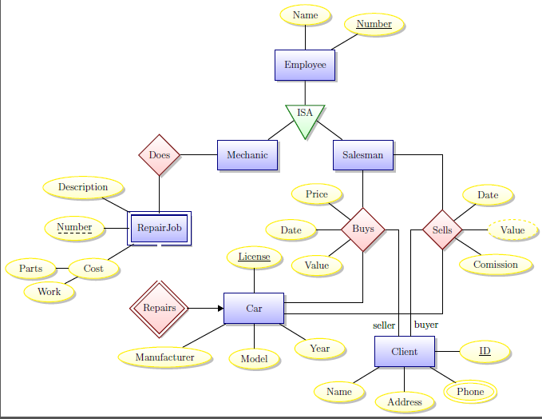
ERD – Example

Slide 24
5. Class-Based Modeling
Class-based Modeling includes:
Identifying classes (often from use cases as a starting point)
Identifying associations between classes
Identifying general attributes and responsibilities of classes
Modeling interactions between classes
Modeling how individual objects change state -- helps identify operations
Checking the model against requirements, making adjustments, iterating through the process more than once
Dept. of CSE, SOE, Presidency University

Slide 25
Identifying Analysis Classes
There are two ways to identify classes:
Natural Language Analysis Method (based on parts of speech)
CRC cards
In Natural Language Analysis method, we map parts of speech to object model components:
Nouns usually map to classes, objects, or attributes
Verbs usually map to operations or associations
Dept. of CSE, SOE, Presidency University

Slide 26
Natural Language Analysis method
Part of speech | model component | Examples
Proper noun | Instance (object) | Alice, Ace of Hearts
Common noun | Class (or attribute) | Field Officer, PlayingCard, value
Doing verb | Operation | Creates, submits, shuffles
Being verb | Inheritance | Is a kind of, is one of either
Having verb | Aggregation/Composition | Has, consists of, includes
Modal verb | Constraint | Must be
Adjective | Helps identify an attribute | a yellow ball (i.e. color)
Dept. of CSE, SOE, Presidency University

Slide 27
Natural Language Analysis method
Categories of Classes:
Entity class -- these represent persistent information tracked by a system. This is the closest parallel to "real world" objects.
Boundary class -- these represent interactions between user and system. (For instance, a button, a form, a display)
Control class -- usually set up to manage a given usage of the system. Often represent the control of some activity performed by a system
Dept. of CSE, SOE, Presidency University

Slide 28
Entity Class
Also called as “Model” or “Business” classes
Terms that are domain-specific in use cases
Recurring nouns
Real-world entities and activities tracked by system
They correspond to “Database Table”
Examples of entity classes are:
Employee
Student
Field Officer
Dept. of CSE, SOE, Presidency University

Slide 29
Boundary Class
Identify general user interface controls that initiate a use case
Identify forms or windows for entering data into a system
Identify messages used by system to respond to a user
Examples of boundary classes are:
Student Attendance Report
Employee Details Capture Form
Dept. of CSE, SOE, Presidency University

Slide 30
Finding Controller Class
  Creation or update of entity objects
  Instantiation of boundary objects as they obtain information from entity objects
  Complex communication between sets of objects
  Validation of data communicated between objects or between the user and the application.
Examples of controller classes are:
Product Controller in a Product automation system
Home Controller in a Home automation system
Dept. of CSE, SOE, Presidency University

Slide 31
Natural Language Analysis method
Applicability
Natural Language Analysis Method is used in:
J2EE: Front-Controller
JSP-Servlets programming
Swing applications
Spring Framework
C# .NET: Page-Controller
MVC (Model-View-Controller) applications
Windows Forms applications
Web Applications
Dept. of CSE, SOE, Presidency University

Slide 32
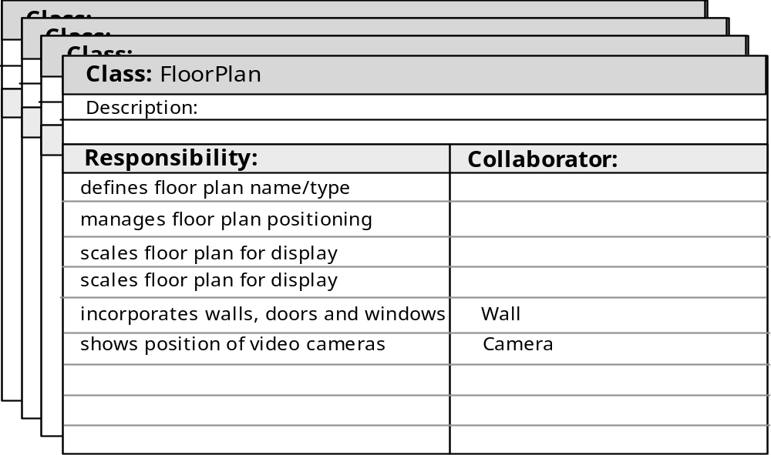
CRC Cards
CRC (Class-Responsibility-Collaborator) modeling provides a mean for identifying and organizing the classes that are relevant to the system.
CRC Layout:
Dept. of CSE, SOE, Presidency University

Slide 33
CRC Cards - Class
Class:
Represents a type of object being modeled
One card per class
Can represent an entity class, boundary class or controller class
Dept. of CSE, SOE, Presidency University

Slide 34
CRC Cards - Responsibility
System intelligence should be distributed across classes to best address the needs of the problem
Each responsibility should be stated as generally as possible
Information and the behavior related to it should reside within the same class
Information about one thing should be localized with a single class, not distributed across multiple classes.
Responsibilities should be shared among related classes, when appropriate.
Dept. of CSE, SOE, Presidency University

Slide 35
CRC Cards - Collaborations
Classes fulfill their responsibilities in one of two ways:
  A class can use its own operations to manipulate its own attributes, thereby fulfilling a particular responsibility, or
  a class can collaborate with other classes.
Collaborations identify relationships between classes
Collaborations are identified by determining whether a class can fulfill each responsibility itself
Three different generic relationships between classes
  the is-part-of relationship
  the has-knowledge-of relationship
  the depends-upon relationship
Dept. of CSE, SOE, Presidency University

Slide 36
CRC Card Session
The general process:
Start with a scenario (usually representing a normal course through a use case)
Identify initial classes/objects and make cards for them (this is can often be done by picking out the nouns)
Going through a scenario helps identify responsibilities of a chosen object
Identify collaborations between objects that have been created
Sometimes, we'll identify a collaboration with a new object type that doesn't have a card yet -- this helps discover new classes
When new classes are created, walk through scenarios again to discover any new responsibilities and collaborators (it's an iterative process)
More use cases/scenarios will yield more classes, responsibilities, and collaborators
Dept. of CSE, SOE, Presidency University

Slide 37
CRC Card Session
Finding responsibilities
  Look for verbs in the scenario descriptions. These often tell us what an object does
  Also ask what the class knows. This tells us what an object needs to store. Sometimes a primary responsibility of a class is management of certain unique information
Finding collaborators
  If a class has a responsibility that required it to get, or modify, information it doesn't have on its own, it will need to collaborate with another class
  Most often, one class specifically initiates the collaboration
  Usually, the collaboration is a request for information or a request to do something
  The initiator's card should list the helper class as a collaborator
  In this case, the initiator class depends on the collaborator class to accomplish its tasks
Dept. of CSE, SOE, Presidency University

